Slide 1
Phase 2

Slide 2

MaN’s
ArCaDe

Slide 3

Building Expansion
Introduction of arcade studios
Introduction of Variable musthyds
Introduction of foresté
Introduction of arcade Wears (Shirts only)
Merch Laundry

Slide 4
Building Expansion
There would have to be some necessary expansions to the Dome arcade building in order to include some more services and features

Slide 5

Arcade studios

Slide 6
the arcade studio room mixes the immersion of a movie theatre with the subtle enclosure, privacy and comfort of your home, with an unlimited access to our several unrivaled services to keep you comfortable and laid back while watching the latest blockbuster movies. Each room is occupied by an air conditioner, couch, table, charging port, high-resolution projector and our complimentary supplements only, a perfect environment for both concentration and hangouts in small groups.
Using a studio room without streaming costs ₦449 (9MST) for 30 minutes

Slide 7
With the comforts of a studio room, we are once again guiding the future by introducing something else never seen before in a movie theatre to assist the arcade studio’s launch.
We are thrilled to introduce an experience Powerful enough to redefine the phrase ‘movie theatre’ with popular series and shows streaming services, why stop there, we have also been able to introduce further streaming from other entertainment apps on a bigger display which includes airplay or screen mirroring for those whose interests aren’t in our millions of movies and shows to offer, truly an experience only found in arcades Studios.

Slide 8
With arcade Studios available, you don’t need to pay the outrageous prices assigned for watching one out of a limited list of movies. You can also save some money while getting way more access to recently released and your old favorite movies compared to the overpriced and non conducive cinema houses around. Our dome arcade services are simply unrivaled not to mention the amount of money you would be saving and the full access to Series and pausing and playing when your ready.

Slide 9
Some Services include
Food on Demand subscription (10MST) monthly
1 season of a show (2SB) for 15 days, up to 3 people
Nick, Disney and Cartoon Network (4SB) for 90 days, up to 6 people
Everything marvel movies (4SB) for 90 days, up to 6 people
One movie only (1SB) for 5 days, up to 6 people
One episode only (5MST) for 5 days, up to 5 people
Five hours daily choice (2SB), up to 6 people
YouTube premium streaming for an hour (12MST), up to 2 people
Five shows first episodes (20MST), up to 5 people
Quick device charge weekly (10MST), up to 10 people
E.T.C.

Slide 10
Introduction of Variable musthyds

Slide 11
Variable Musthyds
The total number of hours spent on our services forms (Variable musthyds)
The Sum of 100 hours of using our services in the arcade = 1 variable musthyds
So, you basically earn variable musthyds by using our services
Customers can sell Variable musthyds For any amount of money
Person with highest number of Variable musthyds every January 23rd wins prizes
All collected Variable musthyds reset after January 23rd
Subscribe to 15 years of merch to allow continuation of variable musthyds collected
Each party pays us 15% the value of the variable musthyds if sold Dome arcade sells 1 Variable musthyds for
Total number of Variable MSTD owned after reset are added up for V points
To allow customers to keep V points they must keep buying merch annually
To ensure customers that aren't members would find it pointless to purchase from us
Customers can buy or sell VMSTD on the app

Slide 12
Introduction of foresté

Slide 13
Different variations of food are available at different budgets to suite the needs of everyone and at different appealing subscriptions
foresté being the name of the restaurant would also make deliveries from the best of restaurants nearby and restaurants exclusive to other cities just for you.
In order to regulate the distributions of the food, all the food eaten in the studio rooms would be from foresté in the Man’s arcade and would remain in the arcade.

Slide 14
What are the food options ?

Slide 15
Basic Menu ( Free access )
Flavors of juice
₦199 refill ₦149
Glass of Water
₦149 refill ₦99
Glass of milk
₦149 refill ₦99
Popcorn
₦649 refill ₦549
Small chops
₦1099 refill ₦949
After each meal at foresté you get a sticker saying the number of times you’ve eaten with us, after 100 times you unlock a studio room shirt and wearing it for the following 20 days consecutively makes you to stand a chance to win 80% off all your meals for as many days in a row that you come and a new iPhone.

Slide 16
Premium menu (₦499 for 6 months of access )
Soft drinks
₦299 refill ₦199
Wafers (10 pcs)
₦399 refill ₦349
Cookies or Crackers (10pcs)
₦399 refill ₦299
Waffles or French toast (10pcs)
₦299 refill ₦199
Suya, Kilishi, shrimps and BBQ
₦1199 refill ₦899
Potato or plantain Chips and chin chin
₦499 refill ₦299
Granola bars
₦499 refill ₦399
Fees payed for the menu access also grants you the ability to taste samples of the food

Slide 17
Top shelf menu (₦999 for 6 months access )
Hot dog
₦899 refill ₦749
Shawarma
₦1299 refill ₦949
Pizza (3 extra large slices )
₦1199 refill ₦999
Ice cream
₦1999 refill ₦1499
Pan cakes
₦799 refill ₦499
Brownies (2 pcs)
₦499 refill ₦349
Sushi
₦2999 refill ₦1999
Taco
₦899 refill ₦749
Ice cream toppings
(skittles, Oreos, chocolates, syrup) Buy individual toppings for (₦199) or up to 5 toppings for only (₦749)
Pancakes (syrups)
(₦99 only)
Buy all syrups or none

Slide 18
Special orders (₦1999 for 5 days access )
Pizza hut (imported)
KFC (imported)
Debonairness
Dominos
Cold stone and pink berry
Sweet tooth
Genesis
Chicken republic
Kilimanjaro
Mr. Biggs
Alcohol brands
ETC
Supported restaurants give change in MST
All imported foods are ₦1000 more expensive per day
Pay the extra ₦5 your orders hot or cold

Slide 19
Arcade wears

Slide 20
Introduction of merchandize (Shirts only)
Man’s Arcade would be proudly introducing its own Merchandize with perks attached to give them more prolonged values.
Arcade calendars advantages
Allows users to keep Vpoints, E.T.C.
Allows users to get free trials and discounts
Gives customers an edge over others
Benefits only apply when you wear the merch to the occasion.
Upgrade your merch by swopping in with us to get the next generation of merchandize 45% off
After swopping you get 5GB of extra data yearly
And 12 free Arcade Cab rides (one each month)
Users can get a Custom pre released color for double the Price.
Arcade wears range in price
(1SB 2Sb 4SB 6SB 8SB 10SB 12SB 14SB 16SB 30SB 32SB 40SB 48SB)

Slide 21
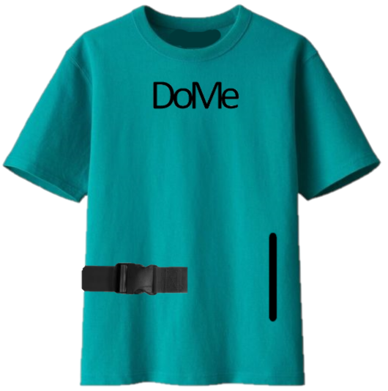
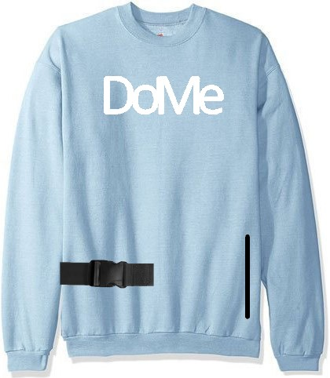
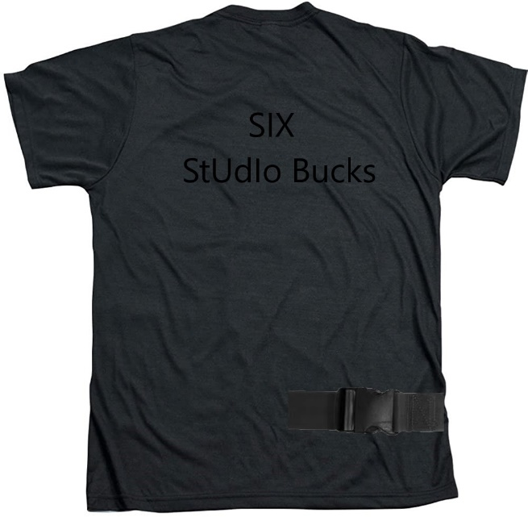
Merchandize Shirt
only 50,000 made annually
New color way Releases on February 28
Contains: 2 plastic belt, waterproof interior, zip able pouch, zipable base, Glow in the dark “arcade”
Shirt only 6SB or (₦15,000)
1 Year after sold out 10SB or (₦25,000)
With sleeves 10SB or (₦25,000)
1 Year after sold out 16SB or (₦40,000)
10% off for Kids (10 years and below)

Slide 22
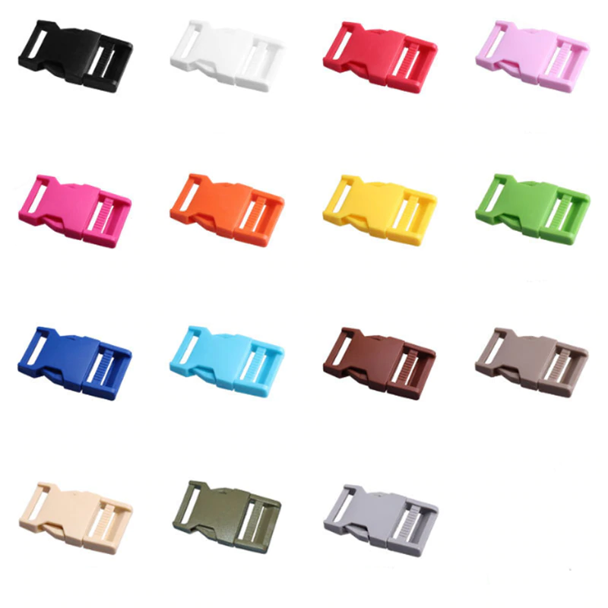
belt buckle
1SB
Per piece

Slide 23
Merch laundry

Slide 24
Merch laundry
Add extra 3SB at checkout to get free laundry twice a week for the year
Customers can pick the Soap Brand, Quantity, use of fragrances, etc.
Laundry must be retrieved from the stores within 2 days
Merch laundry users get 5 backups in case of forgetfulness

